Slide 1
ME316 SIMULATION PROJECT
Adesh Yadav(19010005)

Slide 2
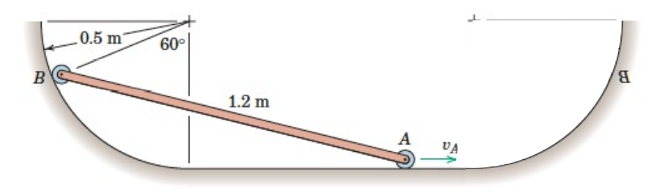
Problem Statement

Slide 3
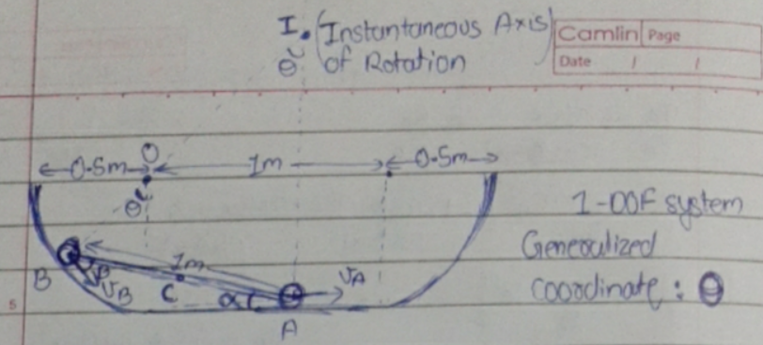


Kinematic Analysis
Degrees of Freedom = 1
Generalised coordinate = θ

Slide 4


Kinematic Analysis
Distance of CoM from I
Velocity of CoM

Slide 5

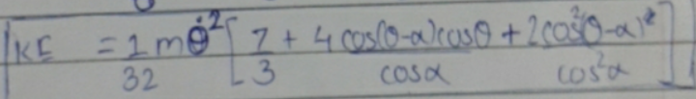
Potential Energy and Kinetic Energy
Potential energy in terms of θ and dθ/dt
Kinetic energy in terms of θ and dθ/dt

Slide 6
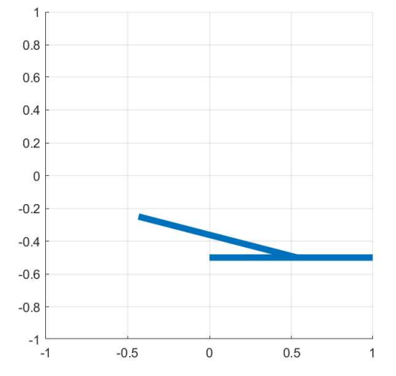
Simulation Window

Slide 7
Links for complete derivation and Matlab code
Complete derivation:
https://drive.google.com/file/d/1g0eFq_3sXDrpyX6pSO7cSbaTuZOxnF7K/view?usp=sharing
Matlab code:
https://drive.google.com/file/d/1ot_ogFrYkSEIV4y9uxpha86xoKE_2p55/view?usp=sharing

Slide 8
Thank You!

